Slide 1
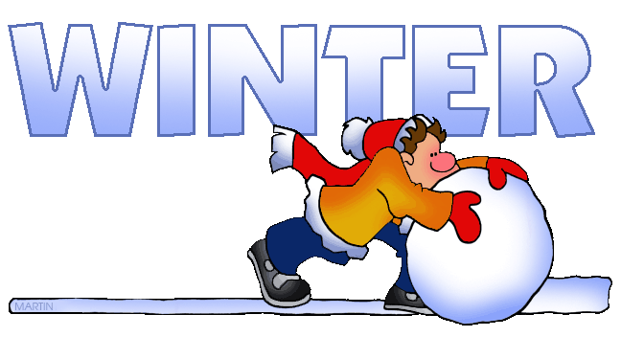
Written by Lin Donn
Illustrated by Phillip Martin

Slide 2
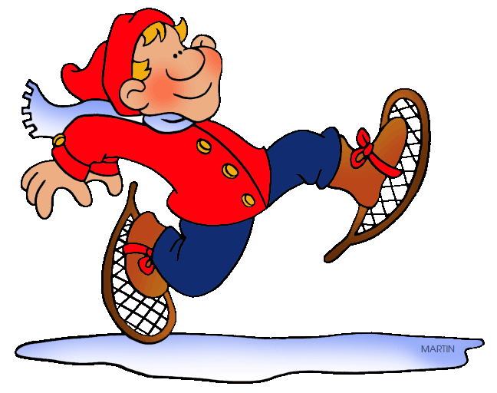
Winter
What makes YOU think of Winter?

Slide 3
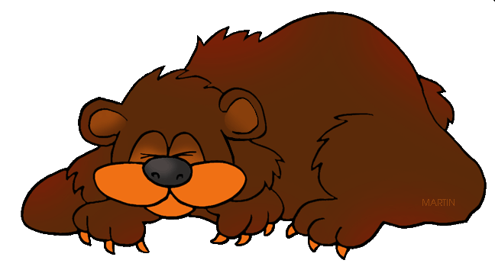
Winter
HIBERNATION
and Migration

Slide 4
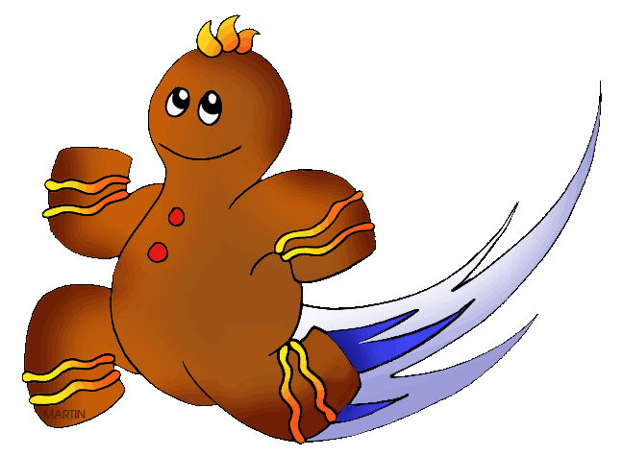
Winter
GINGERBREAD

Slide 5
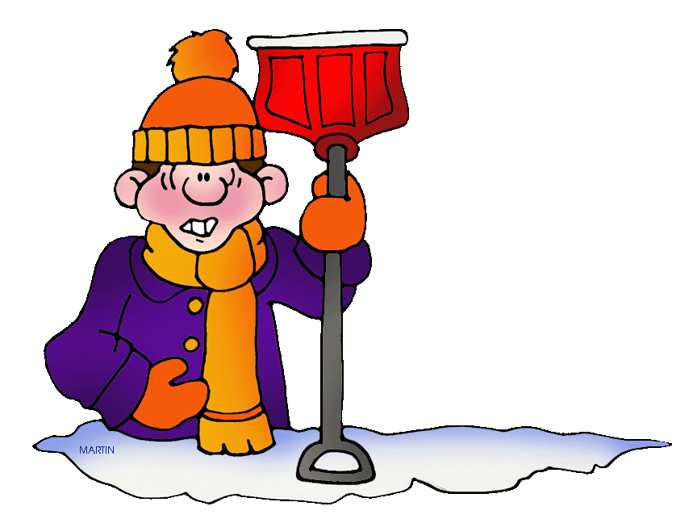
Winter
SNOW
STORMS

Slide 6
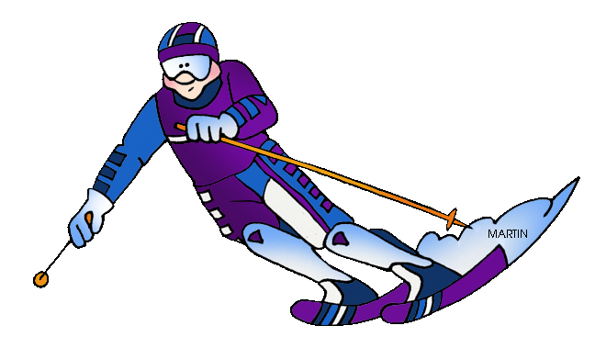
Winter
SNOW SPORTS

Slide 7
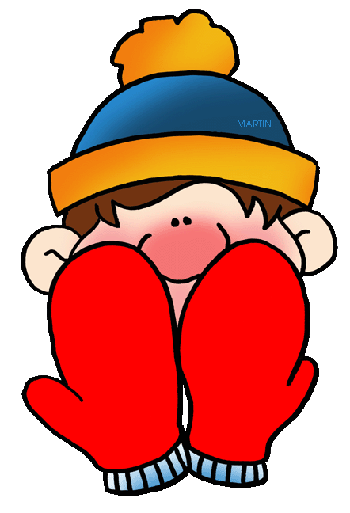
Winter
MITTENS

Slide 8
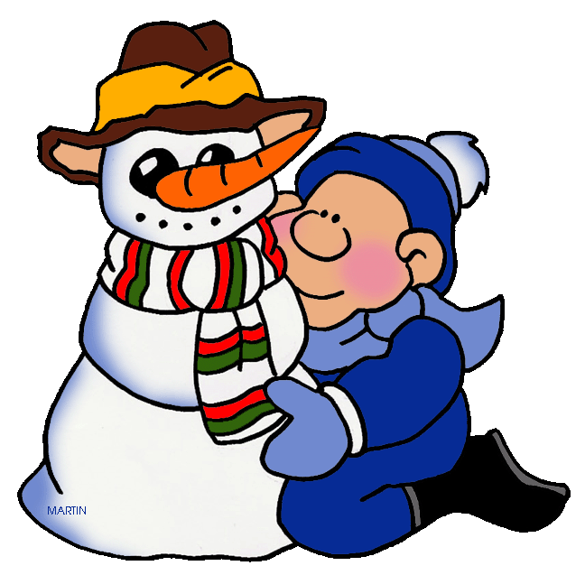
Winter
SNOWMEN

Slide 9
Winter
HANUKKAH

Slide 10
Winter
CHRISTMAS

Slide 11
Winter
KWANZAA

Slide 12
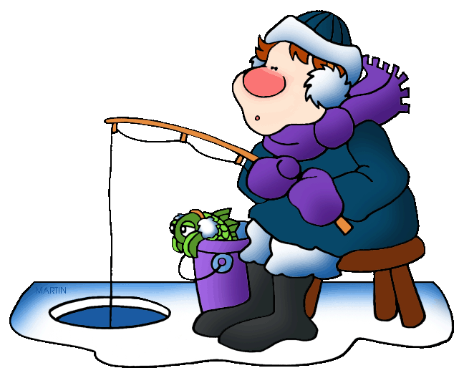
Winter
Click here to learn
more about
Winter.

Slide 13
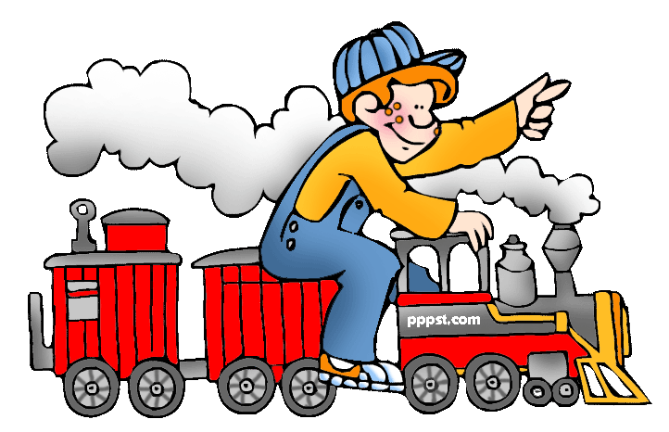
This presentation is brought to you by Pete’s Power Point Station. Visit us on the web at PPPST.COM

