Slide 1
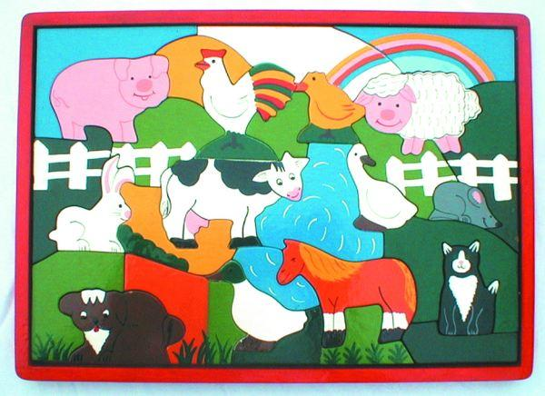
Click on an animal to learn more about it

Slide 2
Pig
Pigs love mud!
Bacon and Sausage comes from pigs
The Three Pigs built houses to protect themselves from Big Bad Wolf

Slide 3
Chicken
Chickens lay eggs
Many people like fried chicken.
Chicken Little thought the sky was falling

Slide 4
Chick
Baby chickens say “peep, peep.”
Baby chicks are yellow when they hatch.
On Old McDonald’s farm there was a chick chick here and a chick chick there.

Slide 5
Lamb
Wool comes from a lamb.
Lamb chops is a puppet and a meal.
“Mary had a little lamb…”

Slide 6
Rabbit
Rabbits don’t lay Easter eggs.
Elmer Fudd thinks Bugs is a “wabbit.”
Peter Rabbit went to Mr. McGregor’s garden.

Slide 7
Cow
Moo says the cow.
Hamburger and steaks come from cows.
In Hey Diddle Diddle a cow jumped over the moon.

Slide 8
Swan
Swans glide across a lake.
Swans have very long necks.
The Ugly Duckling grew into a beautiful swan.

Slide 9
Mouse
Mice say “squeak, squeak, squeak.”
Mice have to hide from hawks and owls.
Three blind mice ran from the farmers wife.

Slide 10
Dog
Dogs wag their tail when they are happy.
Some dogs are very friendly animals.
When the cow jumped over the moon, the little dog laughed.

Slide 11
Duck
Ducks say “quack, quack, quack.”
Donald was a famous Disney duck
Five little ducks went out one day…

Slide 12
Pony
A pony is a young horse.
Pony rides are popular at some zoos.
Yankee Doodle went to town, Riding on a pony.

Slide 13
Cat
Cats spend a lot of time sleeping.
Ancient Egyptians thought cats were gods.
Pussy Cat, Pussy Cat, where have you been?

Slide 14
Thanks
The picture on slide one is the property of Wooden Toys UK and is used with their permission.
Their web site can be seen at:
http://www.woodentoys-uk.co.uk/index.html

