Slide 1
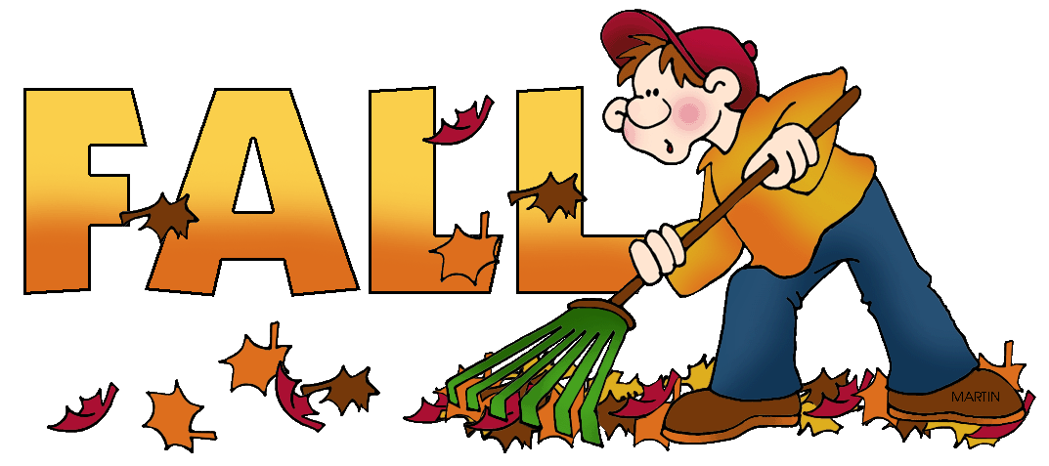
Written by Lin Donn
Illustrated by Phillip Martin

Slide 2
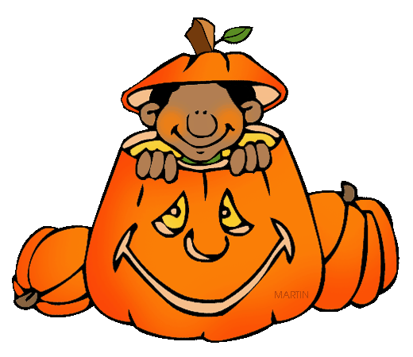
Fall
What makes YOU think of Fall?

Slide 3
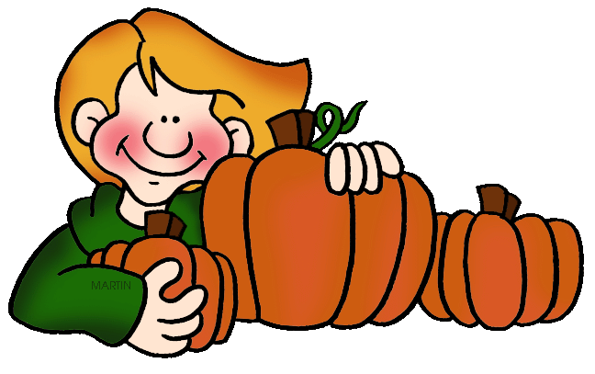
PUMPKINS
Fall

Slide 4
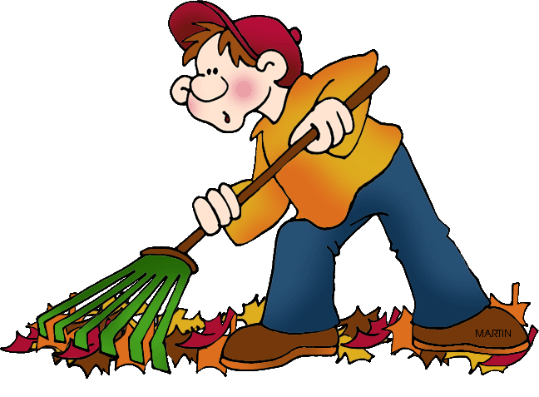
Fall
LEAVES

Slide 5
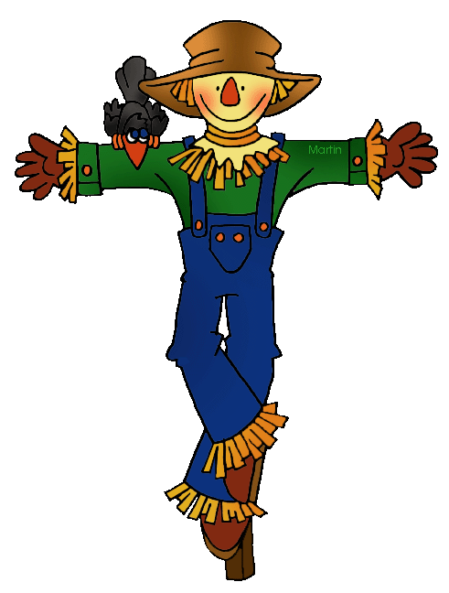
Fall
SCARE CROWS

Slide 6
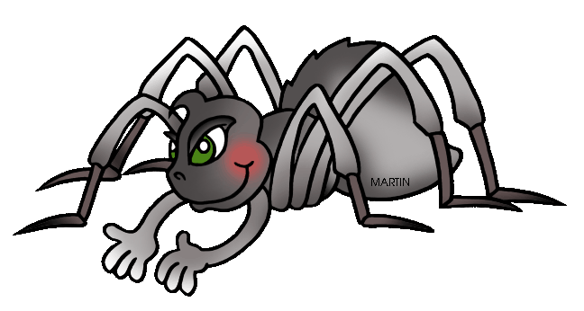
Fall
SPIDERS

Slide 7
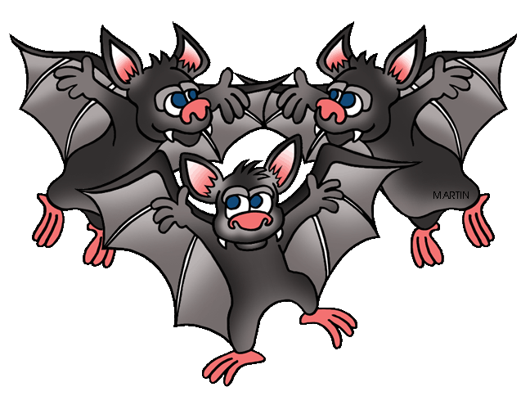
BATS
Fall

Slide 8
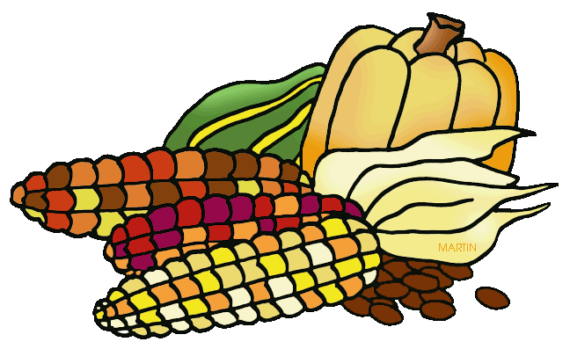
Fall
CORN

Slide 9
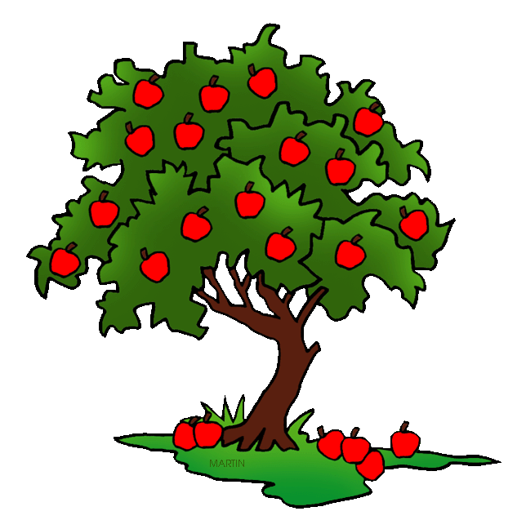
Fall
APPLES

Slide 10
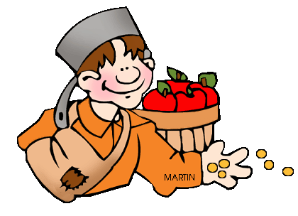
Fall
JOHNNY
APPLESEED

Slide 11
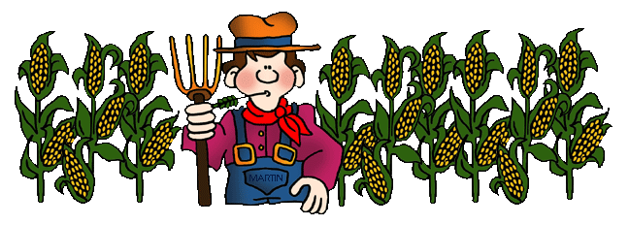
Fall
HARVEST

Slide 12
Fall
Click here to learn
more about Fall.

Slide 13
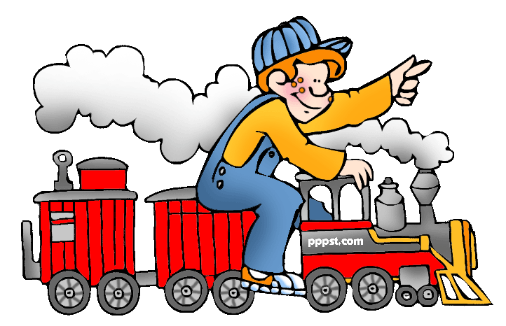
This presentation is brought to you by Pete’s Power Point Station. Visit us on the web at PPPST.COM

