Slide 1
African lions and leopards
BY: Brianna

Slide 2
Lions in general
In general lions are the biggest wild cat in Africa.
They are carnivores and so they eat meat I chose to do my subject on lions because I found them cool.
The most a lion family can have is 2 adults and 4 baby’s .

Slide 3
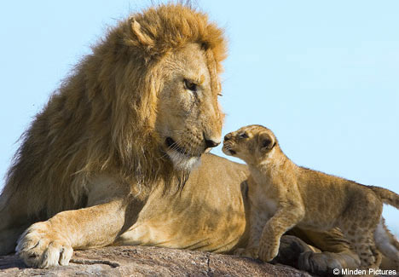
Male lions
Male lions can weight up to 150 - 250 KG
They eat buffalo, zebra, wildebeest, waterbuck birds , young rhinos, hippos, deer and elephant.
Here is a photo of a
Role model lion.

Slide 4
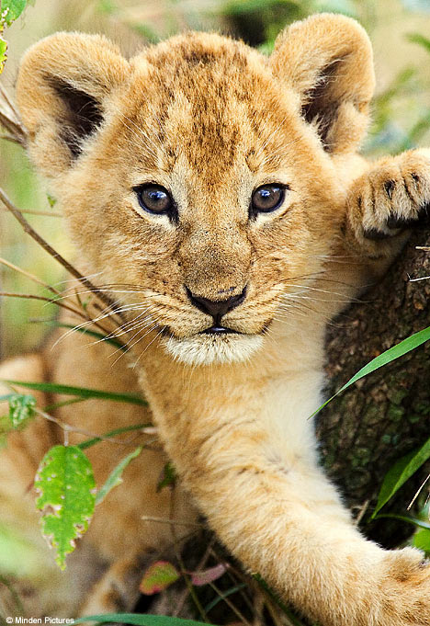
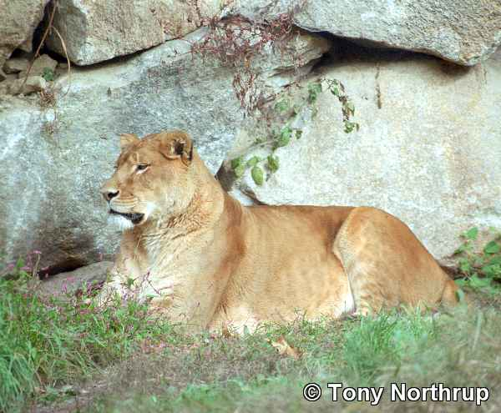
The female lion
Female lions weigh 150kg - 250 kg
They eat zebras deer buffalo rhino hippo and more.
Here is a photo of a female lion and a photo of a cub

Slide 5
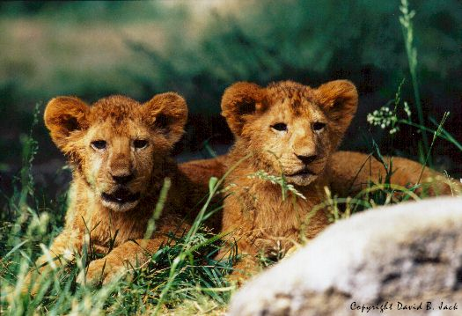
Lion cubs
Lion Clubs like to play as hard as any youngsters. Their playground is the back of a lioness, perhaps their mother.
They eat the same as mothers and fathers do.
Lion cubs like to
Play tag and love
To play rough.

Slide 6
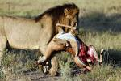
Lions prey
Species killed by lions would be every mammal in its path.
they also eat buffalo, zebra ,wildebeest and more.
They mostly eat buffalo and zebras.
The reason they go for such big animals is because they are big cats and they love eating meat.

Slide 7
Lions habitat
For a suitable habitat for lions consists of semi-arid plains and savannah grasslands.
This habitat is exhibited almost extensively throughout sub-Saharan Africa with the exception of the Congo region.
The savannah grasslands are spotted with Acacia trees which provide shade and resting locations for lions.

Slide 8
Leopards prey
Leopards are the most successful hunters of the cat family. Their prey include Impala, Bushbuck, Warthog and also the young of Wildebeest, Kudu and Waterbuck. Rodents, ground birds, monkeys, baboons, frogs and fish, also make part of it's diet.

Slide 9
Leopards habitat
Leopards are more commonly found along reverie forests and bushes. Although less common, they also can be found along open plains and savannah, mainly in hills and rocky outcrops.

Slide 10
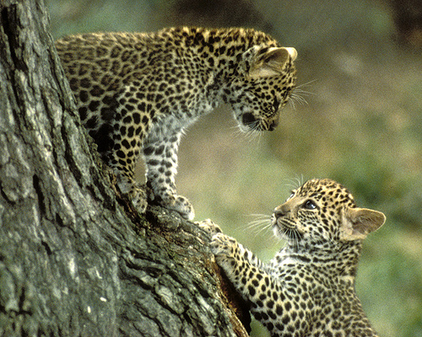
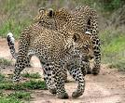
Male leopards
Male leopards weigh 66-155 lb
Leopards are carnivores so they eat a variety of
Foods like for example they eat Monkeys, baboons and many mammals.

Slide 11
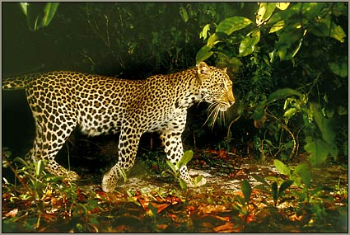
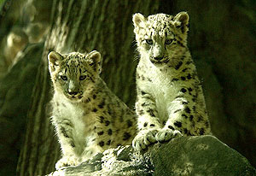
Female leopards
Female leopards weigh 66-155 lb
They eat the same as any leopards would like monkeys deer antelopes and many mammals
Here is a photo of a female leopard and a cub.

Slide 12
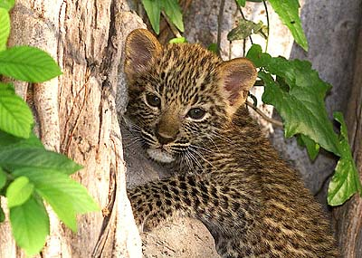
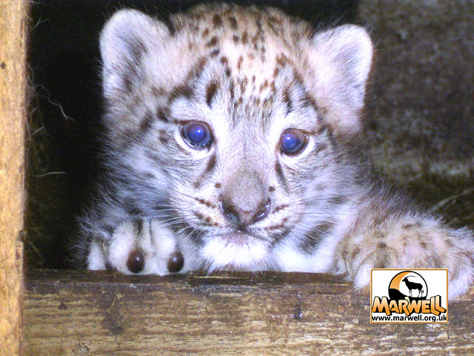
Leopard cubs
Leopard cubs eat baboons, monkeys, deer, antelope ,and other mammals.
Cubs weigh up to 66-155 lb
Leopards love to play rough and they like to run in the sun.

Slide 13
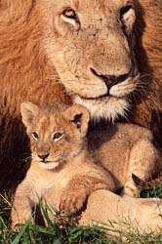
Good bye for know
The End
Everything by Brianna
Web sites:
Google images and search.

