Slide 1
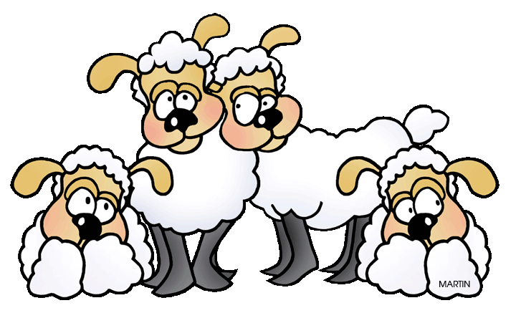
Counting
Sheep
Written by Lin Donn
Illustrated by Phillip Martin

Slide 2
Counting
Sheep
One Sleepy Sheep

Slide 3
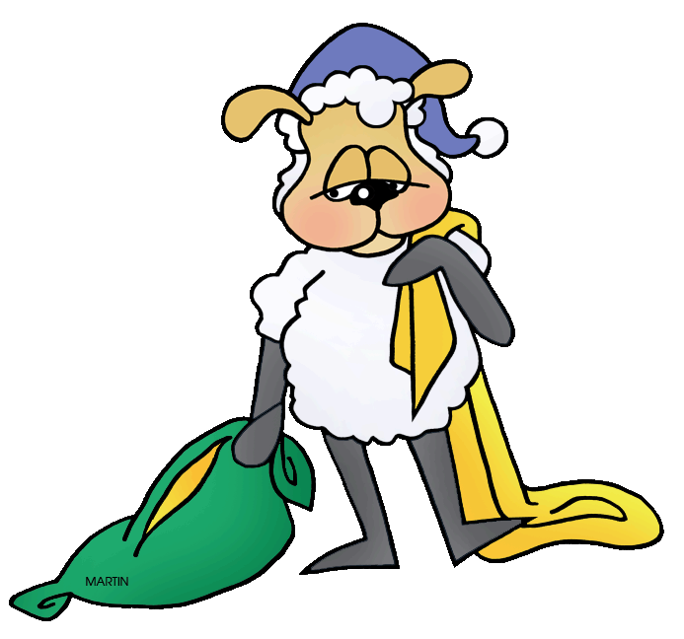
Counting
Sheep
Two Sleepy Sheep

Slide 4
Counting
Sheep
Three Sleepy Sheep

Slide 5
Counting
Sheep
How many sheep are asleep?

Slide 6
Counting
Sheep
Did you say three? Then you are . . .

Slide 7
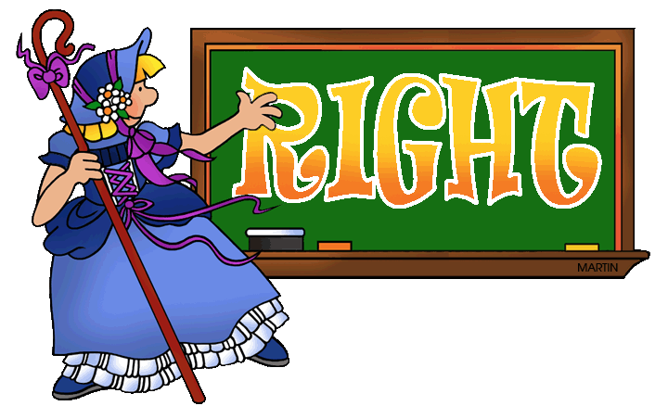
Counting
Sheep

Slide 8
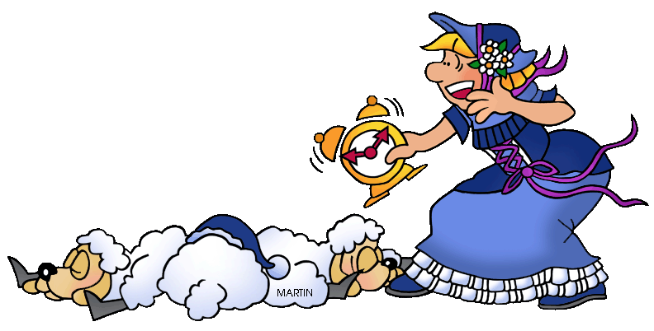
Counting
Sheep
Wake up, Sheep!

Slide 9
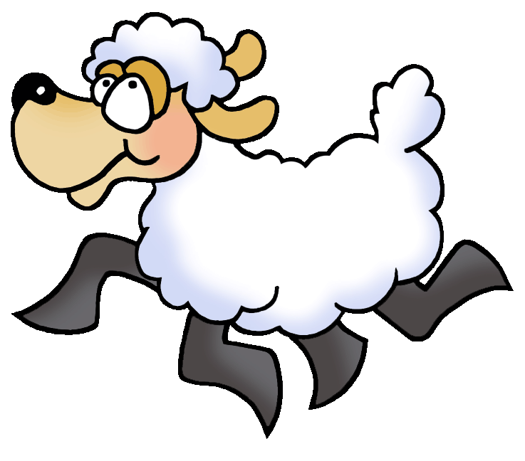
Counting
Sheep
It’s time to go home!

Slide 10
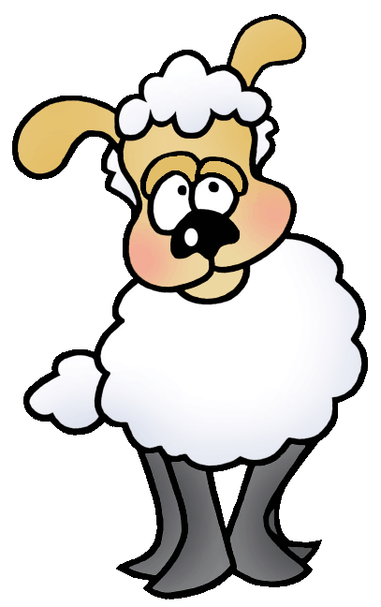
Counting
Sheep
Click here to learn
more about Sheep

Slide 11
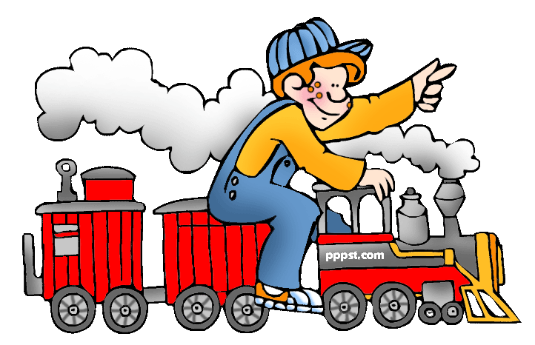
This presentation is brought to you by Pete’s Power Point Station. Visit us on the web at PPPST.COM

